Slide 1

Bachelor of Technology
Computer Engineering Sem : 7
01CE0717 – DevOps Essentials
Unit : 2 - Compile and Build Using Maven and Gradle

Slide 2

Content
Introduction
Installation of Maven, POM files Maven Build lifecycle, Build phases(compile build, test, package) Maven Profiles,
Maven repositories(local, central, global), Maven plugins,
Maven create and build Artifacts,
Dependency management,
Installation of Gradle, Understand build using Gradle

Slide 3
Introduction
Maven is a project management tool.
It is based on Project Object Model (POM).
This tool is used for build, dependency and documentation.
Maven simplifies and standardizes the project build process.
Apache Maven is a popular build automation and project management tool used primarily for Java Projects.
It can be used in building and managing the projects written in C#, ruby and other programming languages.

Slide 4
Introduction
Problems without Maven (Building Java Project without Maven)
Dependency management:
To manage dependency manually (such as downloading library files, ensuring compatibility, manage version control)
It is time consuming and error prone.
Build automation:
Manually create Jar and War files, and its dependencies set up manually
Standardized project structure:
Maven creates a standardized project structure which can be easily grasped by the developers.
Without Maven, It is difficult to set up and maintain the standard project structure that could be followed by all the team members.

Slide 5
Introduction
Problems without Maven (Building Java Project without Maven)
IDE integration:
Many popular IDE provide integration with Maven which allows easy to import, build and manage the whole project.
Without Maven, we need to configure the IDE manually.
Lack of Plugins and community support:
Maven has support for plugins that can simplify various tasks such as deployment and documentation generation.

Slide 6
Introduction
Features of Maven
Simple project setup
Superior dependency management (Automatic updating)
Ability to easily write plugins
To build any number of projects
Work with multiple projects at the same time
Maven encourages the use of a central repository of JARs and other dependencies. Maven comes with a mechanism that can be used to download any JARs required for building your project from a central JAR repository.

Slide 7
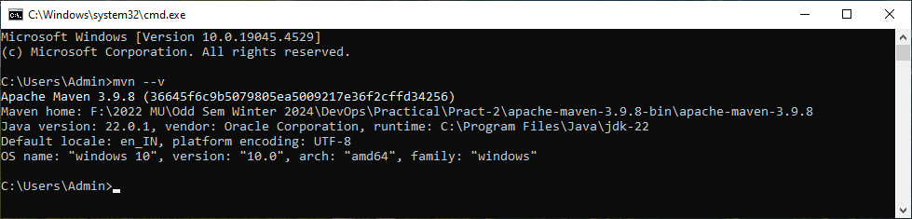
Installation of Maven
Prerequisite
JDK 8 or above
Download from
https://maven.apache.org/download.cgi
Set Environment variable
…\apache-maven-3.9.8-bin\apache-maven-3.9.8\bin
Check version
$mvn --v

Slide 8
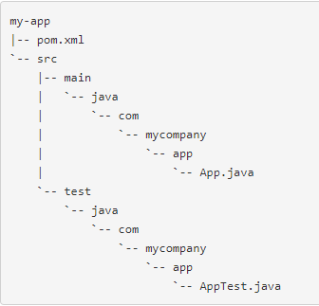
POM files Maven Build lifecycle
https://maven.apache.org/guides/getting-started/maven-in-five-minutes.html
Creating a Project
mvn archetype:generate -DgroupId=com.mycompany.app -DartifactId=my-app -DarchetypeArtifactId=maven-archetype-quickstart -DarchetypeVersion=1.4 -DinteractiveMode=false
you will notice the following standard project structure.

Slide 9
POM files Maven Build lifecycle
Creating a Project
mvn archetype:generate -DgroupId=com.mycompany.app -DartifactId=my-app -DarchetypeArtifactId=maven-archetype-quickstart -DarchetypeVersion=1.4 -DinteractiveMode=false
archetype - refers to a template for generating a new project
groupId – is a unique identifier for your project’s group, typically following the reverse domain name convention (e.g., com.example.myapp)
D – is a flag used to define system properties or configuration parameters
artifactId - is a unique identifier for a project within a group. It is used to define the name of the artifact (e.g., a JAR, WAR, or other packaged output) that will be produced by the project.
archetypeArtifactId - artifact ID of the archetype
archetypeVersion – version of the archetype
interactiveMode – false means no interact with the user //(Batch Mode)

Slide 10
POM files Maven Build lifecycle
Creating a Project
mvn archetype:generate -DgroupId=com.mycompany.app -DartifactId=my-app -DarchetypeArtifactId=maven-archetype-quickstart -DarchetypeVersion=1.4 -DinteractiveMode=false //without interactive
mvn archetype:generate //with Interactive mode

Slide 11
POM files Maven Build lifecycle
https://maven.apache.org/guides/getting-started/maven-in-five-minutes.html
POM Files
Stands for Project Object Model
It is XML file which is named as pom.xml
It is the core of a project's configuration in Maven.
It is a single configuration file that contains the majority of information required to build a project in just the way you want.
It contains information related to the project and configuration information such as
dependencies,
plugins
source directory,
goals and so on.
Maven reads pom.xml file to accomplish its configuration and operations.

Slide 12
POM files Maven Build lifecycle
POM Files
Elements of pom.xml file
project : root element; top level element
modelVersion : It indicates the version model in which the current pom.xml is using.
groupId: It indicates the unique identifier of the organization or group that created project.
arifactId: It indicates the unique base name of the primary artifact being generated by this project. The primary artifact for a project is typically a JAR file. Secondary artifacts like source bundles also use the artifactId as part of their final name.
version : It indicates the version of the artifact generated by the project.

Slide 13
POM files Maven Build lifecycle
POM Files
Additional Elements
name : It indicates the display name used for the Maven project.
url : It indicates where the project's site can be found.
dependencies: The POM lists all the external libraries and dependencies that the project relies on during the build process and runtime.
dependency: It define a dependency. It is used inside dependencies.
plugins: Maven allows developers to use various plugins to extend its functionality during the build process. The POM defines which plugins are applied to the project and the respective configurations.
scope : It is used to define the scope for this maven project.

Slide 14
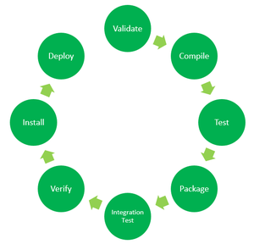
POM files Maven Build lifecycle
Maven Build Lifecycle

Slide 15
POM files Maven Build lifecycle
Maven Build Lifecycle
validate: It confirms that all the data necessary for the build is available.
Compile: compile the source code of the project.
test: test the compiled source code using a suitable unit testing framework.
package: It take the compiled code and package it in its distributable format, such as a JAR.
verify: run any checks on results of integration tests to ensure quality criteria are met.
install: install the package into the local repository, for use as a dependency in other projects locally.
deploy: Final package is deployed into a remote repository.

Slide 16
POM files Maven Build lifecycle
Maven Goals
In Maven, each phase is a sequence of goals. The purpose of each goal in Maven is to perform in specific task.
When we build our Maven project, we need to specify the Goal.
Some of the popular goals are –
validate
compile
test
package
install
deploy
The build phases are executed sequentially. Any maven build phases that come before the specified phase is also executed. For example, if we run “mvn package” then it will execute compile, test and package phases of the project.

Slide 17
POM files Maven Build lifecycle
Built-in Build Life Cycle Phase
Maven comes with 3 built-in build life cycles as shown below:
Clean: cleans up artifacts created by prior builds;
It performs the cleaning operation in which it deletes the build directory name target and its contents for a fresh build and deployment. To perform this operation we use command mvn clean
Default: complete deployment of the project
Site: This phase handles the generating java documentation of the project.

Slide 18
Maven Profiles
A Maven profile is a way to customize the build process in Maven, the popular build automation tool for Java projects. Profiles allow you to define a set of configurations and settings that can be activated under specific conditions, such as for different environments (development, testing, production) or different platforms.
Different Types of Build Profiles:
Per Project : Defined in the POM itself (pom.xml)
Per User/Developer : Defined in the Maven-settings (%USER_HOME%/.m2/setting.xml)
Global : Defined in the global Maven-settings (%M2_HOME%/conf/settings.xml)

Slide 19
Maven Repositories
Maven repository is a directory where all the project jars, plugins, library jars or any other project related artifacts are stored and these can be accessed by Maven easily.
There are three Types of repositories in Maven:
Local repository
Central repository
Remote repository

Slide 20
Maven Repositories
There are three Types of repositories in Maven:
Local repository
Stored on the developer’s machine
Acts as a cache of downloaded dependencies
When we execute any Maven project that requires dependencies, Maven downloads these dependencies from central or remote repository and store them on developer’s machine
Typically located in the “.m2” directory in the user’s home directory
Example location: “C:\Users\Admin\.m2\repository”

Slide 21
Maven Repositories
There are three Types of repositories in Maven:
Central repository
Maven central can be accessed from https://repo.maven.apache.org/maven2.
Maintained by the Maven community.
Whenever we execute our Maven project then, required dependencies are first searched in the local repository, if those dependencies are not present in the local repository then those are downloaded from the central repository and are stored in the local repository for the future use.

Slide 22
Maven Repositories
There are three Types of repositories in Maven:
Remote repository
Third-party repositories or internal repositories managed by organizations
Used for hosting custom, private or third-party dependencies not available in the central repository.
Defined in the project’s “pom.xml” file or maven settings.
Maven repositories are essential for managing project dependencies efficiently, ensuring consistent builds, and promoting the reuse of libraries and components in Java projects.

Slide 23
Maven Plugins
Maven plugins are core components of the Apache Maven build automation tool.
They provide additional tasks and goals that can be executed during the build process of a Maven project.
Plugins are used to perform various build and project management operations, such as compiling code, packaging binaries, running tests, generating documentation, and deploying artifacts.
Types of Maven Plugins
Build Plugins
Reporting Plugins

Slide 24
Maven Plugins
Types of Maven Plugins
Build Plugins :
These are used to execute tasks during the build process.
These plugins are declared inside <build> element.
Compiler Plugin: Compiles the project's source code.
Surefire Plugin: Runs the unit tests of a project.
Jar Plugin: Packages the compiled code into a JAR file.
War Plugin: Packages web applications into a WAR file.
Assembly Plugin: Creates distributions with the project binaries and dependencies.

Slide 25
Maven Plugins
Types of Maven Plugins
Reporting Plugins :
These are executed at the time of site generation.
These plugins are declared inside the element <reporting>.
Site Plugin: Generates a project website.
Javadoc Plugin: Generates Java API documentation.
PMD Plugin: Integrates PMD (a source code analyzer) to generate reports.

Slide 26
Maven Plugins
Core Maven Plugins
clean : clean up after the build
compiler : Compiles Java sources
deploy : Deploy the built artifact to the remoter repository
failsafe : Run the JUnit integration tests in an isolated classloader
install : Install the built artifact into the local repository
resources : Copy the resources to the output directory for including in the JAR
site : Generate a site for the current project.
surefire : Run the JUnit unit tests in an isolated classloader
verifier : Useful for integration tests – it verifies the existence of certain conditions

Slide 27
Maven Plugins
Benefits of Maven Plugins
Modularity: Adds modularity to the build process, allowing various tasks to be performed through plugins.
Reusability: Enables the reuse of common build logic across different projects.
Customizability: Plugins can be configured and customized as needed in the ‘pom.xml’.
Extensibility: New plugins can be created and added to Maven repositories, extending Maven's capabilities.
Maven plugins are essential tools that extend Maven's functionality, allowing you to automate and manage various aspects of your project's build lifecycle.

Slide 28
Dependency Management
In Maven, a dependency is just another archive-JAR, ZIP, and so on-which our current project needs in order to compile, build, test, and/or run.
These project dependencies are collectively specified in the pom.xml file, inside of a <dependencies> tag.
When we run a maven build or execute a maven goal, these dependencies are resolved and then loaded from the local repository.
If these dependencies are not present in the local repository, then Maven will download them from a remote repository and cache them in local.
Dependency management is an important activity because to build a product we need several library files, plugins or some external dependencies. We have to be sure that all these components are compatible for building our product. This task can be taken care by dependency management.

Slide 29
Dependency Management
Example:
Transitive dependency
$mvn dependency:tree
Excluding dependency
<exclusion> tag

Slide 30
Gradle
Introduction to Gradle
Open source build automation tool
The build automation tool is a tool that automates the creation of software build. Build automation is the process of automating the retrieval of source code, compiling it into binary code, executing automated tests and publishing it into a shared, centralized repository.
Gradle is a general purpose build tool and its main focus is Java Projects.

Slide 31
Gradle
Features of Gradle
Free and Open Source tool
High Performance
Better Support compare to Ant tool
Scaling : It can increase the productivity, from simple and single project to huge multi-project builds.
Multi-project builds
IDE Support: It has support for several IDEs. Gradle also generates the required solution files to load a project into Visual Studio.

Slide 32
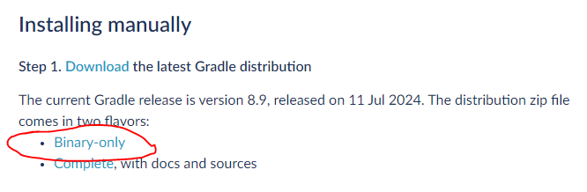
Installation of Gradle
Prerequisite
JDK 8 or above
Download from
https://https://gradle.org/install/
Configure the Environment variable.

Slide 33
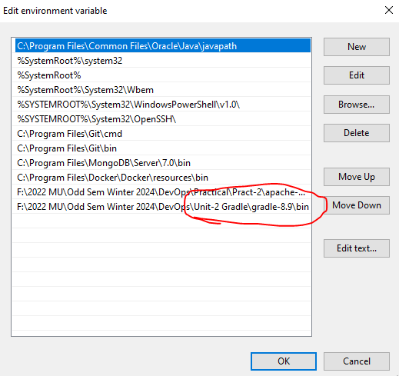
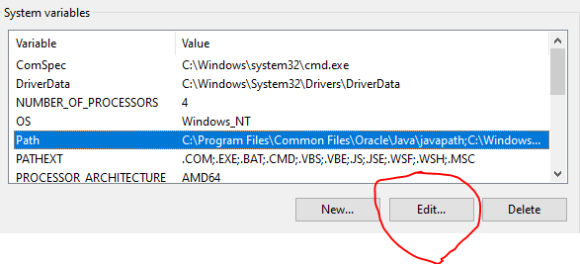
Installation of Gradle
Set Environment variable
F:\2022 MU\Odd Sem Winter 2024\DevOps\Unit-2 Gradle\gradle-8.9\bin

Slide 34
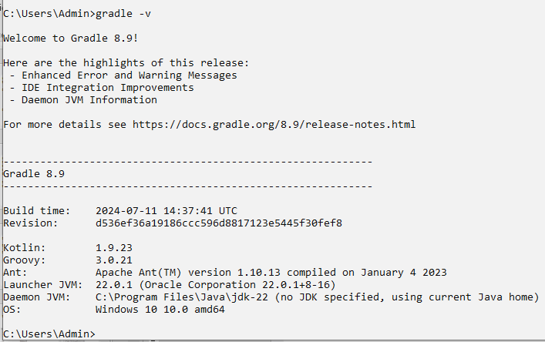
Installation of Gradle
Open CMD and issue the command gradle –v. It will display the following screen.

Slide 35
Understand Build using Gradle
Core Concepts
Project: Gradle project represents the application that can be deployed to the staging environment.
Task: A task referes to a piece of work performed by a build. For example – the task can be creating a Jar file, compiling classes, or making JavaDoc.
Build Script: Every Gradle build represents one or more projects. This build script is written using the domain specification language called groovy. This script is saved as build.gradle.

Slide 36
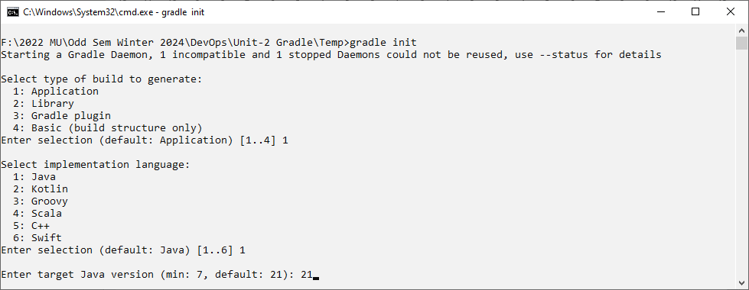
Creating Gradle Project using CMD
$gradle init

Slide 37
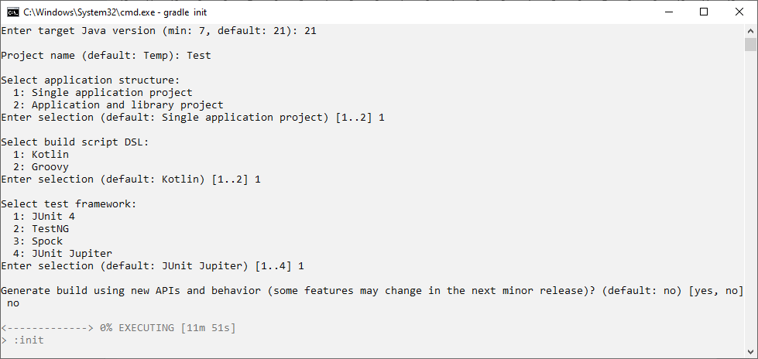
Creating Gradle Project using CMD
$gradle init

Slide 38
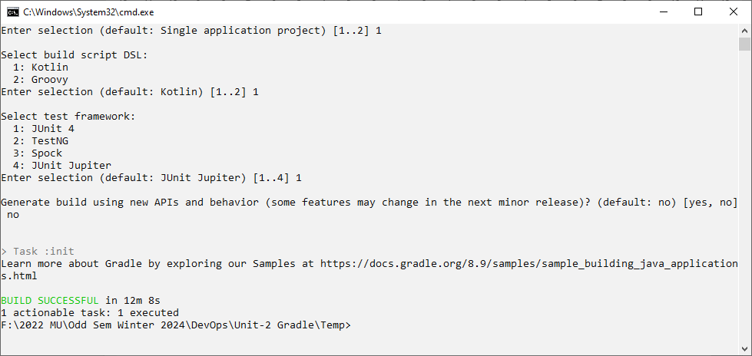
Creating Gradle Project using CMD
$gradle init

Slide 39
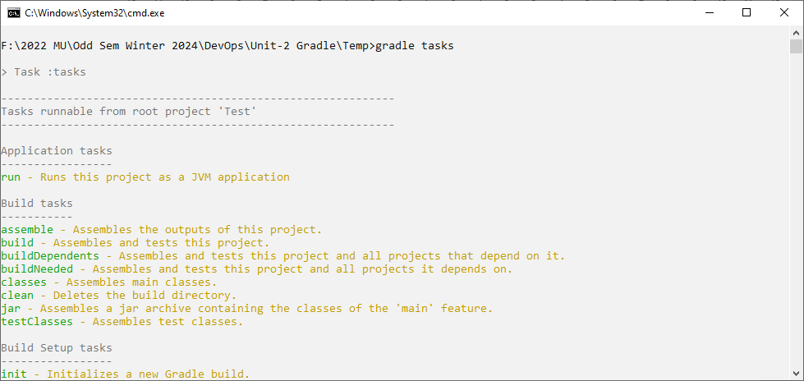
Creating Gradle Project using CMD
$gradle tasks

Slide 40
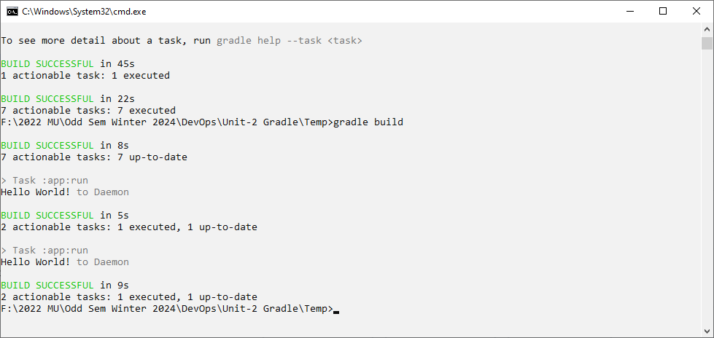
Creating Gradle Project using CMD
$gradle build
$gradle run

Slide 41
Understanding build using Gradle
Maven | Gradle
Maven is a tool used form generating Java based projects. | Gradle is a tool which can be used to develop domain-specific language projects.
It is uses the XML (pom.xml) to create project structure. | It uses Groovy/kotlin based Domain Specification Language (DSL) for creating the project structure.
Java compilation is compulsory for the Maven tool | Java compilation is not compulsory for the Gradle tool

Slide 42


